Slide 1


<Bryan>
<4/28/2022>

Slide 2

Outline
Executive Summary
Introduction
Methodology
Results
Conclusion
Appendix

Slide 3
Executive Summary
Summary of methodologies
EDA, including data collection, data wrangling, data visualization and interactive visual
Python Machine Learning
Summary of all results
EDA allowed to identify which features are the best to predict success of landing
Machine Learning showed the best classification model to predict which characteries are important to drive this opportunity by the best way, using all collected data

Slide 4
Introduction
Project background and context
Predicting the success rate of first stage rocket landing and their costs
Problems you want to find answers
The best way to estimate the total cost for launches, by predicting successful landings of first stage of rockets;
Where is the best place to make launches.

Slide 5

Section 1

Slide 6
Methodology
Executive Summary
Data collection methodology:
Data collection using SPACEX API and web scraping
Perform data wrangling
Using Python library of Pandas, Numpy to manipulate data
Perform exploratory data analysis (EDA) using visualization and SQL
Perform interactive visual analytics using Folium and Plotly Dash
Perform predictive analysis using classification models
Standardize the data, and using models of SVM, KNN, LogisticRegression, DecisionTree to train the data, using GridSearchCV to evaluate models and chose the best model.

Slide 7
Data Collection
Data sets were collected from SpaceX API(https://api.spacexdata.com/v4/rockets) and from Wikipedia(https://en.wikipedia.org/wiki/List_of_Falcon\_9\_and_Falcon_Heavy_launches) using web scraping.

Slide 8
Data Collection – SpaceX API
SpaceX offers a public API from where data can be obtained and then used;
The API was used according to the flowchart beside and then data is persisted
Source code:
https://github.com/Bryan-zZ/Testing/blob/master/Space%20X%20Project-Data%20Collecting.ipynb
Request API and parse the SpaceX launch data
Filter data to only include Falcon9 launches
Deal with Missing data

Slide 9
Data Collection - Scraping
Data from SapceX launches can also be obtained from Wikipedia;
Dara Sources: https://github.com/Bryan-zZ/Testing/blob/master/%20Space%20X%20Project-Web%20Scraping%20lab.ipynb
Request the Falcon9 Launch Wiki page
Extract all columns/variable names from the HTML table header
Create a DataFrame by parsing the launch HTML tabels

Slide 10
Data Wrangling
Initially some EDA was performed on the dataset.
Then the summaries launches per site, occurrences of each orbit and occurrence of mission outcome per orbit type were calculated.
Finally, the landing outcome label was created from outcome column.
Source code: https://github.com/Bryan-zZ/Testing/blob/master/Space%20X%20Project-Data%20Wrangling.ipynb
EDA
Summarizations
Creation of landing outcome label

Slide 11
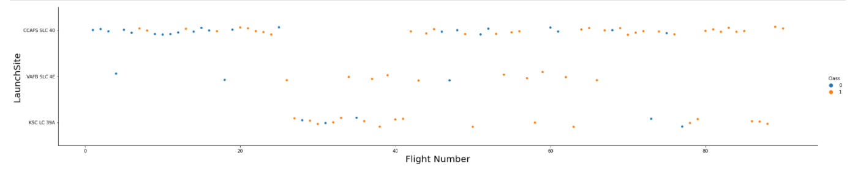
EDA with Data Visualization
To explore data, scatterplots and barplots were used to visualize the relationship between pair of features:
Payload Mass X Flight Number, Launch Site X Flight Number, Launch Site X Payload Mass, Orbit and Flight Number, Payload and Orbit
Source code: https://github.com/Bryan-zZ/Testing/blob/master/Space%20X%20Project-Data%20Visualization.ipynb

Slide 12
EDA with SQL
The following SQL queries were performed:
The names of the unique launch sites in the space mission
Where launch sites begin with the string 'CCA’
The total payload mass carried by boosters launched by NASA (CRS)
Average payload mass carried by booster version F9 v1.1
List the date when the first successful landing outcome in ground pad was achieved
List the names of the boosters which have success in drone ship and have payload mass greater than 4000 but less than 6000
List the total number of successful and failure mission outcomes
List the names of the booster_versions which have carried the maximum payload mass. Use a subquery
List the failed landing_outcomes in drone ship, their booster versions, and launch site names for in year 2015
Rank the count of landing outcomes (such as Failure (drone ship) or Success (ground pad)) between the date 2010-06-04 and 2017-03-20, in descending order
Source code: https://github.com/Bryan-zZ/Testing/blob/master/Space%20X%20Project-EDA%20with%20SQL%20Lab.ipynb

Slide 13
Build an Interactive Map with Folium
Markers, circles, lines and marker clusters were used with Folium Maps
Marker indicate points like launch sites;
Circles indicate highlighted areas around specific coordinates, like NASA Johnson Space Center;
Marker clusters indicate groups of events in each coordinate, like launches in a launch site;
Lines are used to indicate distance between two coordinates.
Source code: https://github.com/Bryan-zZ/Testing/blob/master/Space%20X%20Project-Interactive%20Visual%20Analytics%20.ipynb

Slide 14
Build a Dashboard with Plotly Dash
The following graphs and plots were used to visualize data
Percentage of launches by site
Payload range
This combination allowed to quickly analyze the relation between payloads and launch site, helping to identify where is best place to launch according to payloads.
Source code: https://github.com/Bryan-zZ/Testing/blob/master/Space%20X%20Dash%20Plot.py

Slide 15
Predictive Analysis (Classification)
Four classification models were compared: Logistic Regression, SVM, Decision Tree and KNN
Source code: https://github.com/Bryan-zZ/Testing/blob/master/Space%20X%20Project-Predictive%20Analysis.ipynb
Data preparation and standardization
Test of each models with combinations of hyperparameters
Comparison of results

Slide 16
Results
Exploratory data analysis results
Space X uses 4 different launch sites;
The first launches were done to Space X itself and NASA;
The average payload of F9 v1.1 booster is 2928kg;
The first success landing outcome happened in 2015 fiver year after the first launch;
Many Falcon 9 booster versions were successful at landing in done ships having payload above the average;
Almost 100% of mission outcome were successful;
Two booster versions failed at landing in drone ships in 2015: F9 v1.1 B1012 & F9 v1.1 B1015;
The number of landing outcome became as better as years passed.

Slide 17
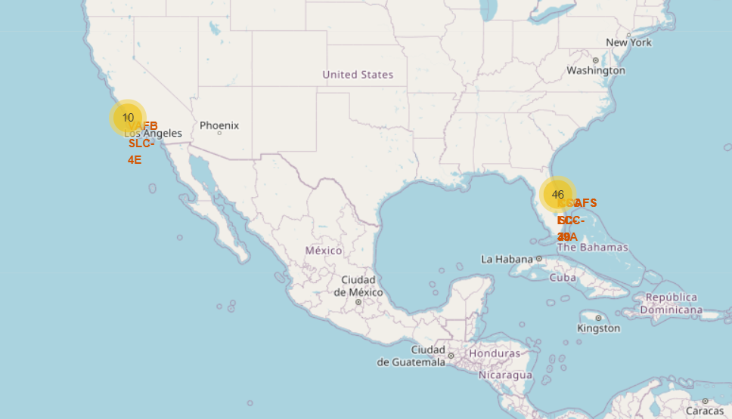
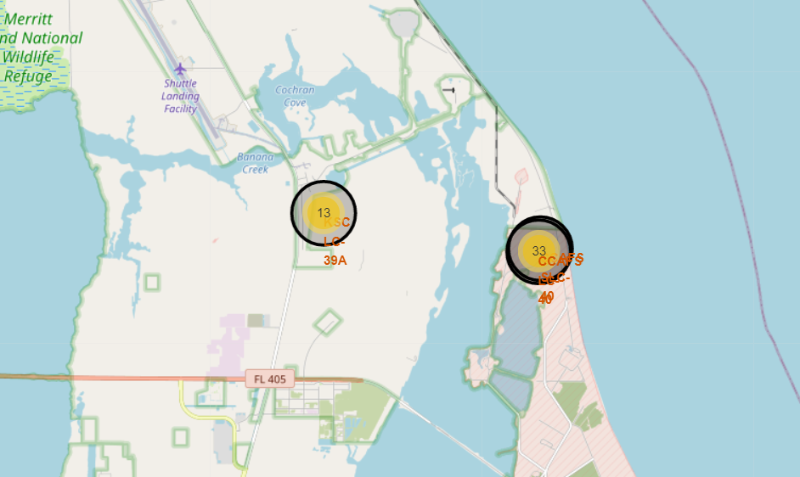
Results
Using interactive analytics was possible to identify that launch site use to be in safety places, near sea, for example and have a good logistic infrastructure around.
Most launches happens at east cost launch sites.

Slide 18

Section 2

Slide 19
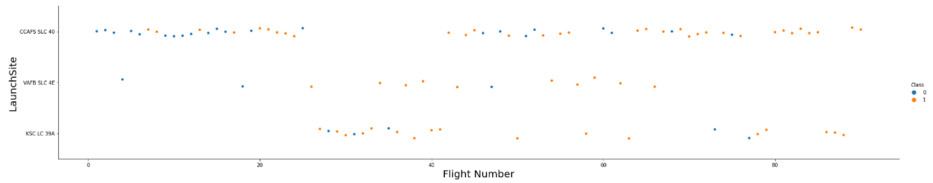
Flight Number vs. Launch Site
Show the screenshot of the scatter plot
According to the plot above, it’s possible to verify that the best launch site nowadays is CCAF5 SLC 40, where most of recent launches were succeccful;
In second place VAFB SLC 4E and third place KSC LC 39A;
It’s also possible to see that the general success rate improve over time.

Slide 20
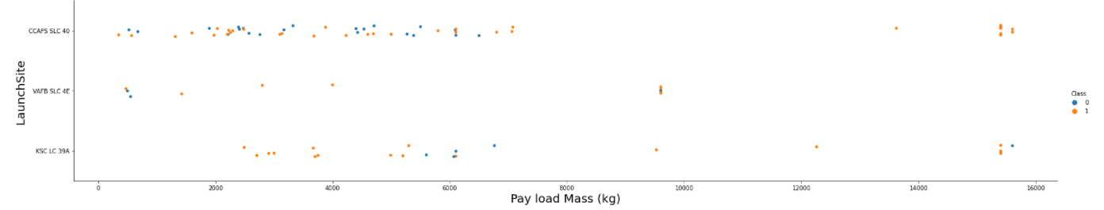
Payload vs. Launch Site
Payloads over 9000kg have excellent success rete;
Payloads over 12000kg seems to possible only CCAFS SLC 40 and KSC LC 39A launch sites.

Slide 21
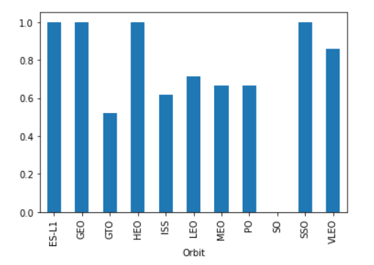
Success Rate vs. Orbit Type
The biggest success rates happens to orbits:
ES-L1
HEO
GEO
SSO
Followed by:
VLEO (above 80%)
LFO (above 70%)

Slide 22
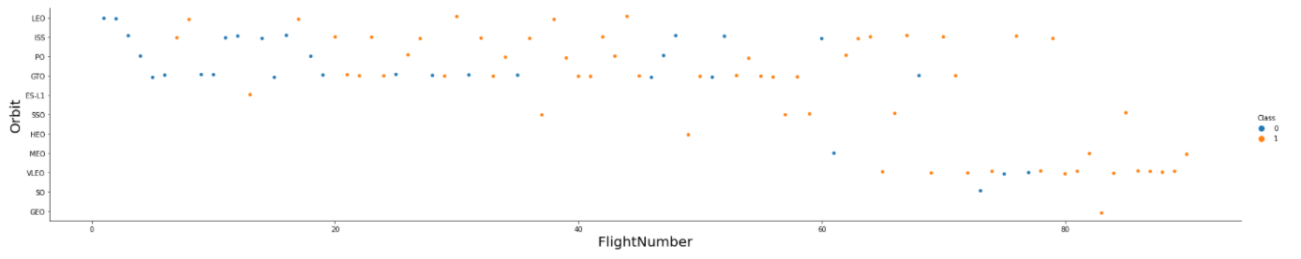
Flight Number vs. Orbit Type
Apparently, success rate improved over time to all orbits;
VLEO orbit seems a new business opportunity, due to recent increase of its frequency.

Slide 23
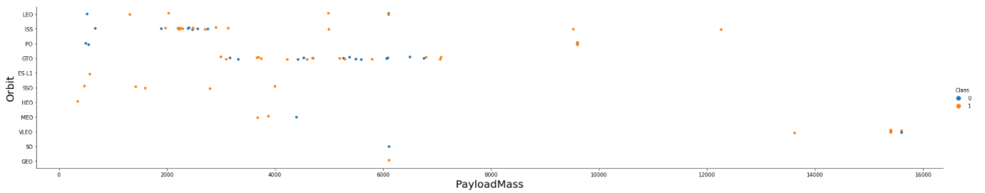
Payload vs. Orbit Type
Apparently, there is no relation between payload and success rate to orbit GTO;
ISS orbit has the widest range of payload and a good rate of success;
There are few launches to the orbits SO and GEO.

Slide 24
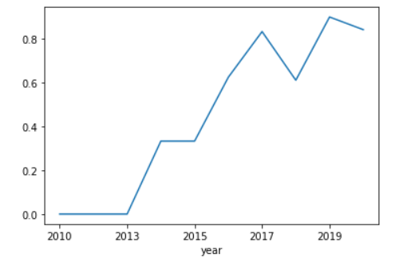
Launch Success Yearly Trend
Success rate stared increasing in 2013 and kept until 2020;
It seems that the first three years were a period of adjusts and improvement of technology.

Slide 25
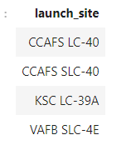
All Launch Site Names
There are four launch sites:

Slide 26
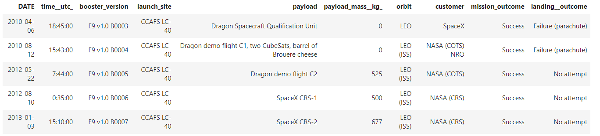
Launch Site Names Begin with 'CCA'
5 records where launch sites begin with ‘CCA’:

Slide 27
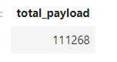
Total Payload Mass
Total payload carried by boosters from NASA:
Total payload calculated above, by summing all payloads whose codes contain ‘CRS’, which corresponds to NASA.

Slide 28
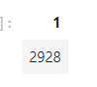
Average Payload Mass by F9 v1.1
Average payload mass carried by booster version F9 v1.1:
Filtering data by the booster version above and calculating the average payload mass we obtained the value of 2928kg.

Slide 29
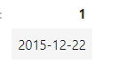
First Successful Ground Landing Date
First successful landing outcome on ground pad:
By filtering data by successful landing outcome on ground pad and getting the minimum value for data it’s possible to identify the first occurrence, that happened on 12/22/2015.

Slide 30
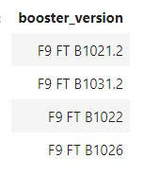
Successful Drone Ship Landing with Payload between 4000 and 6000
Boosters which have successfully landed on drone ship and had payload mass greater than 4000 but less than 6000
Selecting distinct booster version according to the filter above, these 4 are the result.

Slide 31
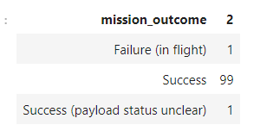
Total Number of Successful and Failure Mission Outcomes
Number of successful and failure mission outcomes:
Grouping mission outcomes and counting records for each group led us to the summary above.

Slide 32
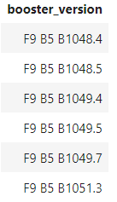
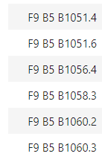
Boosters Carried Maximum Payload
Boosters which have carried the maximum payload mass:
There are the boosters which have carried the maximum payload mass registered in the dataset.

Slide 33
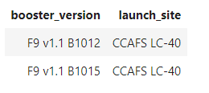
2015 Launch Records
Failed landing outcome in drone ship, their booster versions, and launch site names for in year 2015
The list above has the only two occurrences.

Slide 34
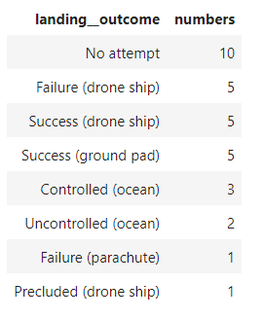
Rank Landing Outcomes Between 2010-06-04 and 2017-03-20
Ranking of all landing outcomes between the date 2010-06-04 and 2017-03-20:
This view of data alerts us that “No attempt” must be taken in account.

Slide 35

Section 3

Slide 36
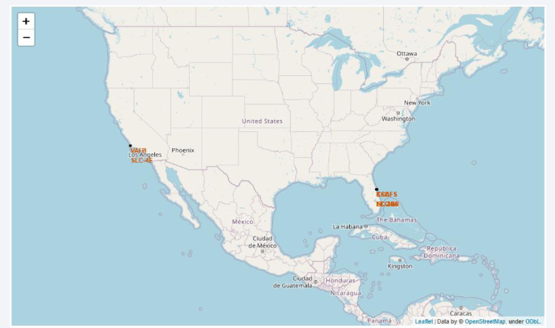
All Launch Sites
Launch sites are near sea, probably by safety, but not too far from roads and railroads.

Slide 37
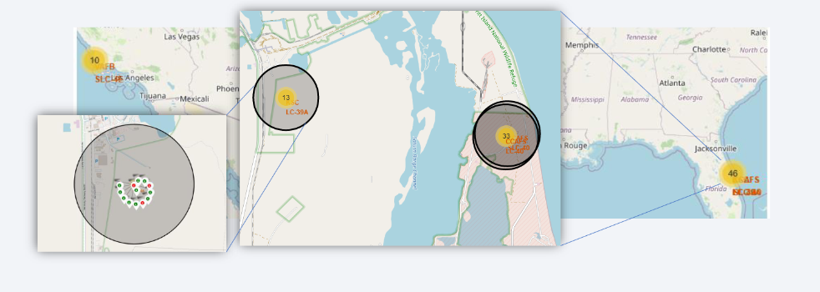
Launch Outcomes by Site
Example of KSC LC-39A launch site launch outcomes
Green markers indicate successful and red ones indicate failure.

Slide 38
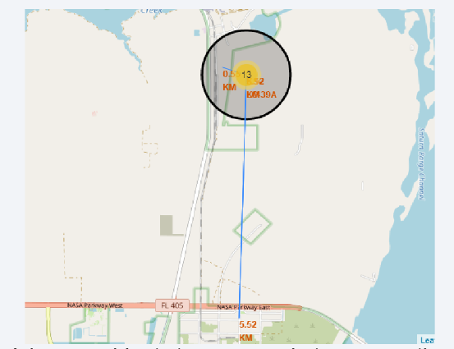
Logistics and Safety
Launch site KSC LC-39A has good logistics aspects, being near railroad and road and relatively far from inhabited areas.

Slide 39

Section 4

Slide 40
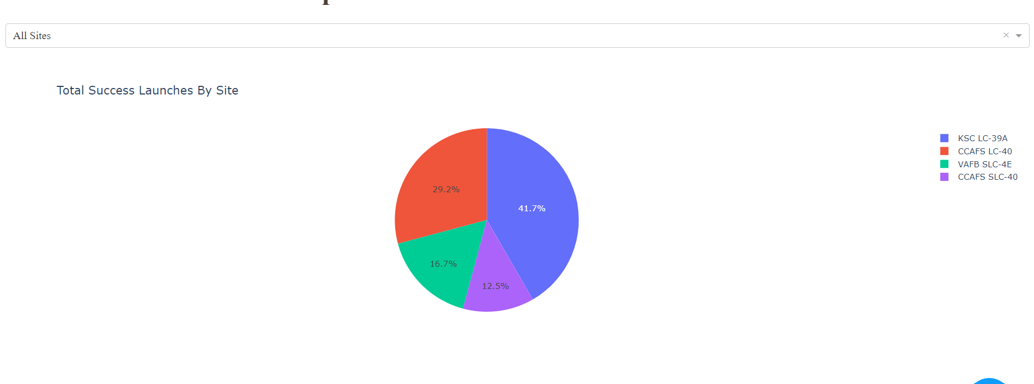
Successful Launches by Site
The place from where launches are done seems to be a very important factor of success of missions.

Slide 41
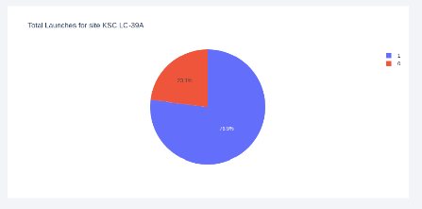
Launch Success Ratio for KSC LC-39A
76.9% of launches are successful in this site.

Slide 42
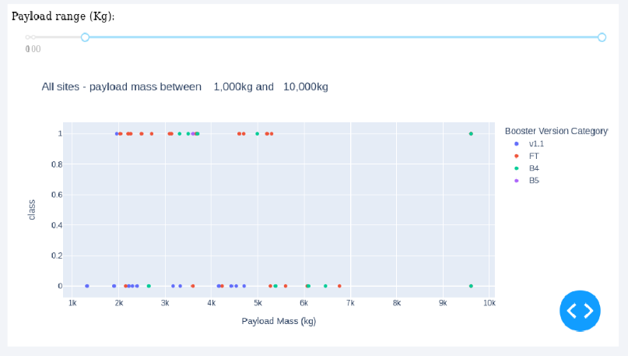
Payload vs. Launch Outcome
Payload under 6000kg and FT boosters are the most successful combination.

Slide 43

Section 5

Slide 44
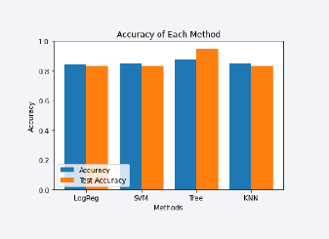
Classification Accuracy
Four classification models were tested, and their accuracies are plotted beside;
The model with the highest classification accuracy is Decision Tree Classifier, which has accuracies over than 89%.

Slide 45
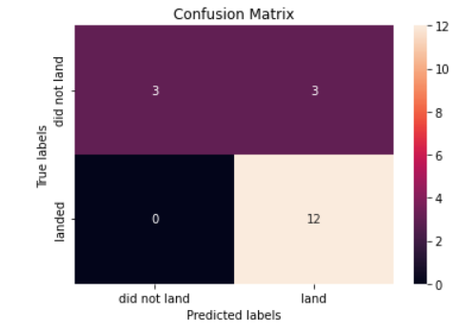
Confusion Matrix of Decision Tree
Confusion matrix of Decision Tree Classifier proves its accuracy by showing the big numbers of true positive and true negative compared to the false ones.

Slide 46
Conclusions
Different data sources were analyzed, refining conclusions along the process;
The best launch site is KSC LC-39A;
Launches above 7000kg are less risky;
Although most of mission outcomes are successful, successful landing outcomes seem to improve over time, according the evolution of processes and rockets;
Decision Tree Classifier can be used to predict successful landing and increase profits.

Slide 47
Appendix
Include any relevant assets like Python code snippets, SQL queries, charts, Notebook outputs, or data sets that you may have created during this project

Slide 48


